Slide 1
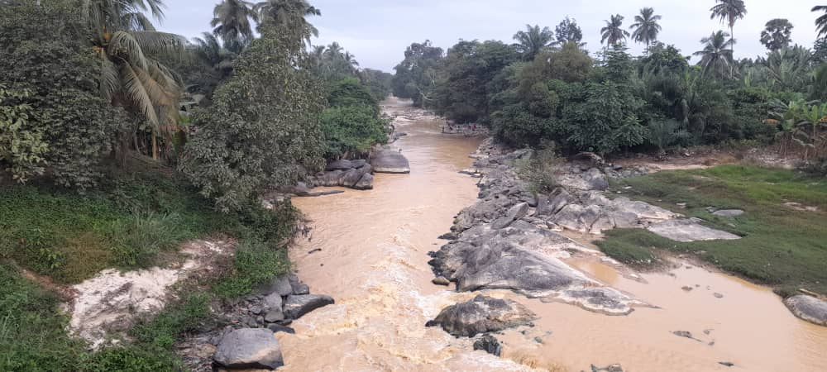





OPEN FOR CLIMATE JUSTICE
OCTOBER 24 – 30, 2022
#OAWEEK2022
TEAM MEMBERS
Jeremiah Mensah
Kenneth Dzomeku
Emmanuel Amoani Ofori (Co-opted)
Patience A. Buah
Albertha G. Ampofo (Coordinator)
Gloria Pomfowaa
Peter Anafo

Slide 2

Open Access Definition
Open Access (OA) refers to any literature published electronically on the internet, and freely available to the public permitting users to read, download, copy, distribute and search for information (Mavodza, 2013).
The University Library

Slide 3
Significance of Open Access (OA)
Open Access (OA) makes scholarly materials freely available online to all users without having to pay subscription fees.
OA also makes it possible for researchers, students etc. to publish and achieve a worldwide audience.
The University Library

Slide 4
International Open Access Week Celebrations
International open access week was established by Scholarly Publishing and Academic Resources Coalition (SPARC) and its partners in 2008, with the aim that, everyone should be able to access and contribute to the knowledge that shapes our world today.
The University Library

Slide 5
Theme for OA celebration 2022 #OAWeek2022
Open for Climate Justice
This year’s theme, “Open for Climate Justice”, seeks to encourage collaboration among the Open Access movement and the international open community in that, sharing knowledge is a human right, and tackling the climate crisis requires the rapid exchange of knowledge across geographic, economic and disciplinary boundaries.
Climate Justice is an acknowledgement that the climate crisis have widespread devastating effects, and its impacts are not being borne equally or fairly between rich and poor, and between developing and developed nations as noted by the United Nations.
The University Library

Slide 6
Theme for OA celebration 2022 #OAWeek2022
Open for Climate Justice
According to Scholarly Publishing and Academic Resources Coalition (SPARC), the proponent of the ‘International Open Access Week’, these power imbalances also affect communities abilities to produce, disseminate and use knowledge needed to address the climate crisis.
Openness to resources, can create pathways to more equitable knowledge sharing and serve as a means to address the inequities that influence the impact of climate change and our response to them.
The University Library

Slide 7
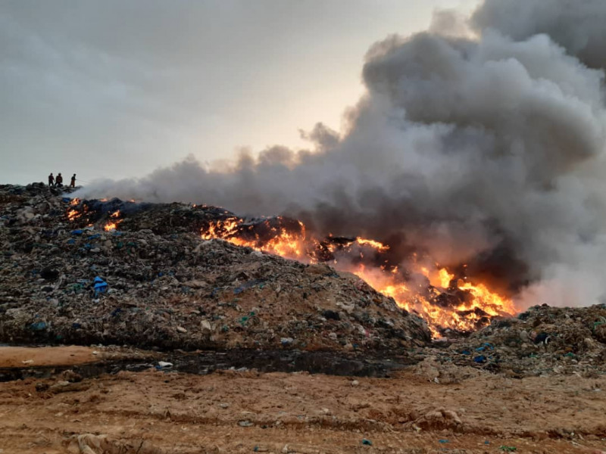
Sections of the presentation
This presentation is in four parts and includes:
Photographs on the impact of climate change on the environment and the effects of illegal mining activities on water bodies.
Compilation of national newspaper articles on the environment and ‘galamsey’ activities.
Open Access portals for educational/scholarly resources.
Presentation on access to content on Research4Life, an Open Access electronic database.
The University Library

Slide 8
Some photographs of the impact of the climate crises in Ghana, including devastating effects of illegal mining activities on river bodies.
The University Library

Slide 9
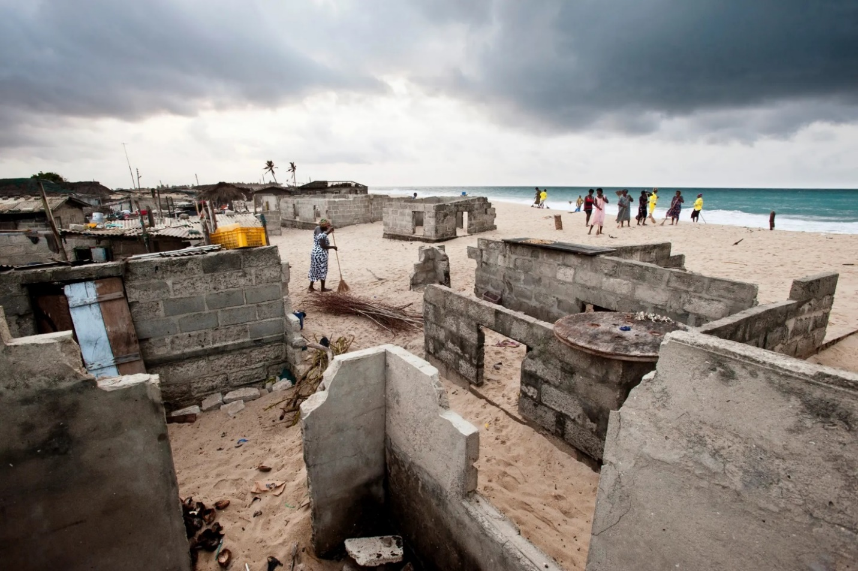
The fishing village of Totope, Ada, in the Greater Accra Region is disappearing as the rising sea and worsening coastal erosion bury buildings in sand. The villagers say they were once three miles from the sea. Here women sweep sand towards the sea in a forlorn attempt to prevent their homes from being buried completely.
Photograph: Nyani Quarmyne/Panos Pictures
Source: https://www.theguardian.com/global-development-professionals network/gallery/2016/oct/07/ghana-villages-destroyed-climate-change-in-pictures#img-1
Accessed: 30th September, 2022.
The University Library

Slide 10
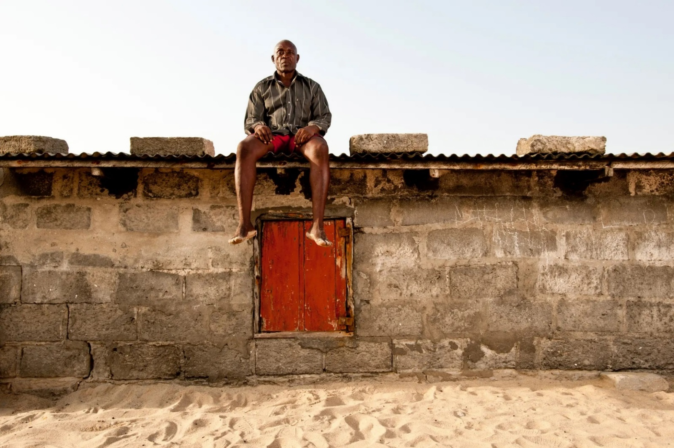
Tekpe Hongah, a resident of Totope, sits on the roof of his rapidly disappearing home. Fearful that the building might collapse at any time, he has been forced to evacuate and move in with relatives.
Photograph: Nyani Quarmyne/Panos Pictures
Source: https://www.theguardian.com/global-development-professionals-network/gallery/2016/oct/07/ghana-villages-destroyed-climate-change-in-pictures#img-2
Accessed: 30th September, 2022.
The University Library

Slide 11
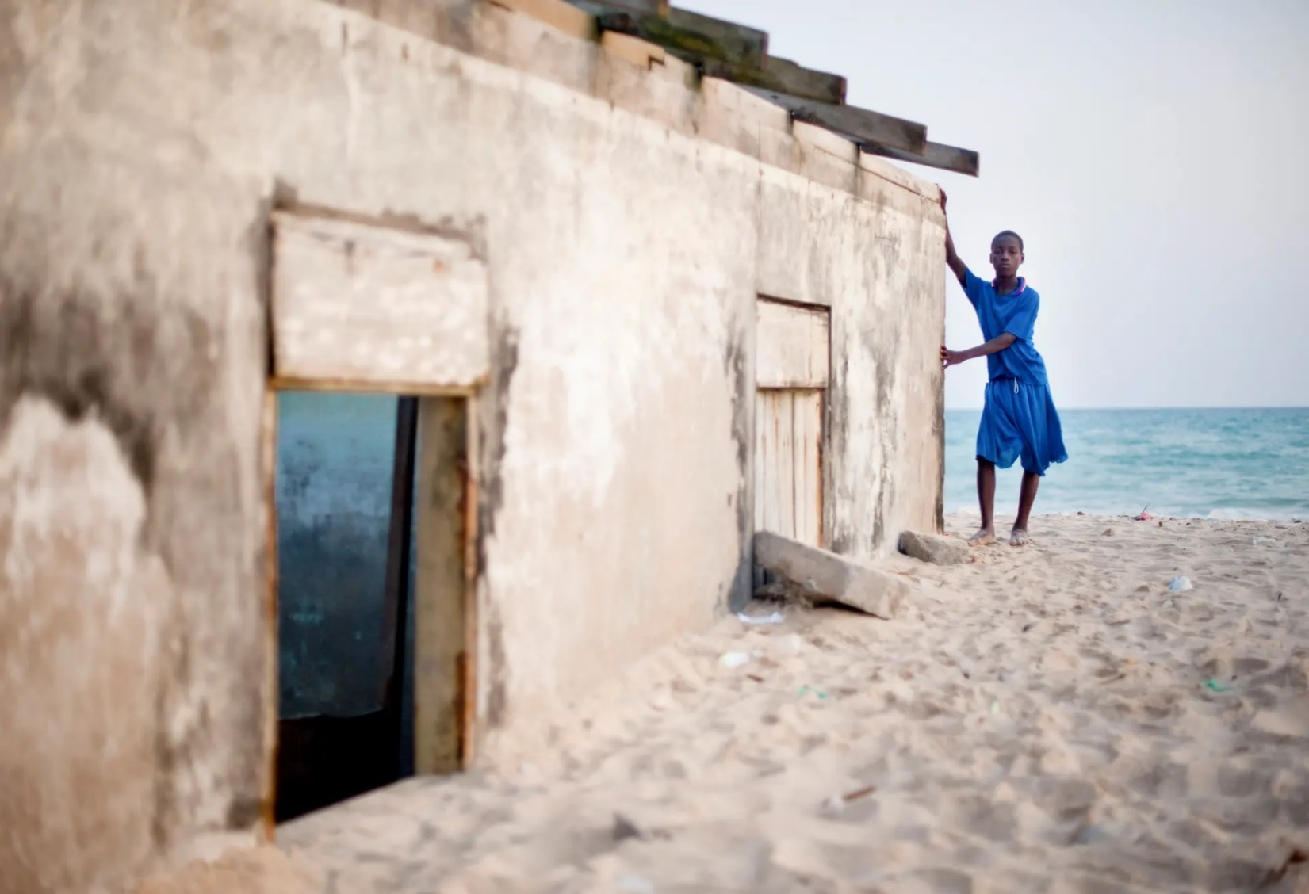
Torgborfio Obodai, a schoolboy from Totope, stands by a house that is being claimed by the sea and sand. When the ravages of the sea are at their worst, he is unable to walk the short distance to school for fear of being swept out into the ocean.
Photograph: Nyani Quarmyne/Panos Pictures
Source: https://www.theguardian.com/global-development-professionals-network/gallery/2016/oct/07/ghana-villages-destroyed-climate-change-in-pictures#img-4
Accessed: 30th September, 2022.
The University Library

Slide 12
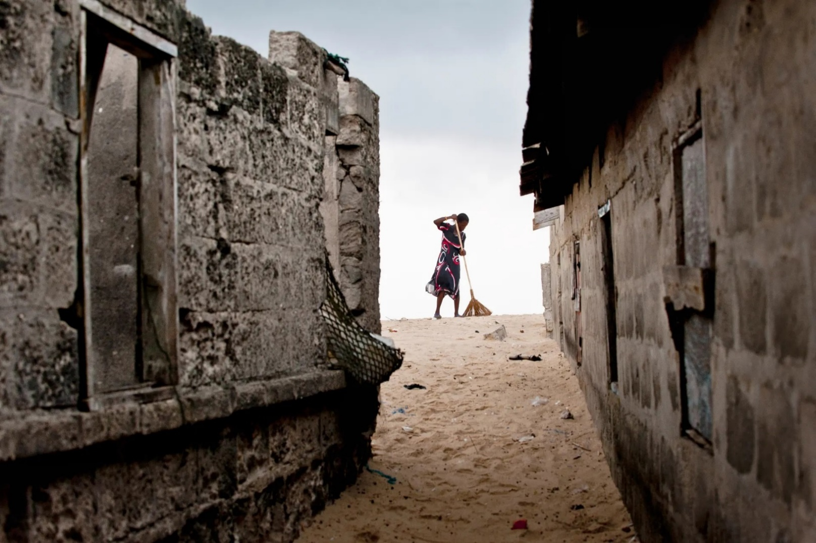
Every morning the women of Totope, sweep the beach and bury the rubbish that has been swept down the coast overnight from the cities of Accra and Tema. As the sea continues to advance on the village, it periodically buries homes in sand and rubbish.
Photograph: Nyani Quarmyne/Panos Pictures
Source: https://www.theguardian.com/global-development-professionals-network/gallery/2016/oct/07/ghana-villages-destroyed-climate-change-in-pictures#img-7
Accessed: 30th September, 2022.
The University Library

Slide 13
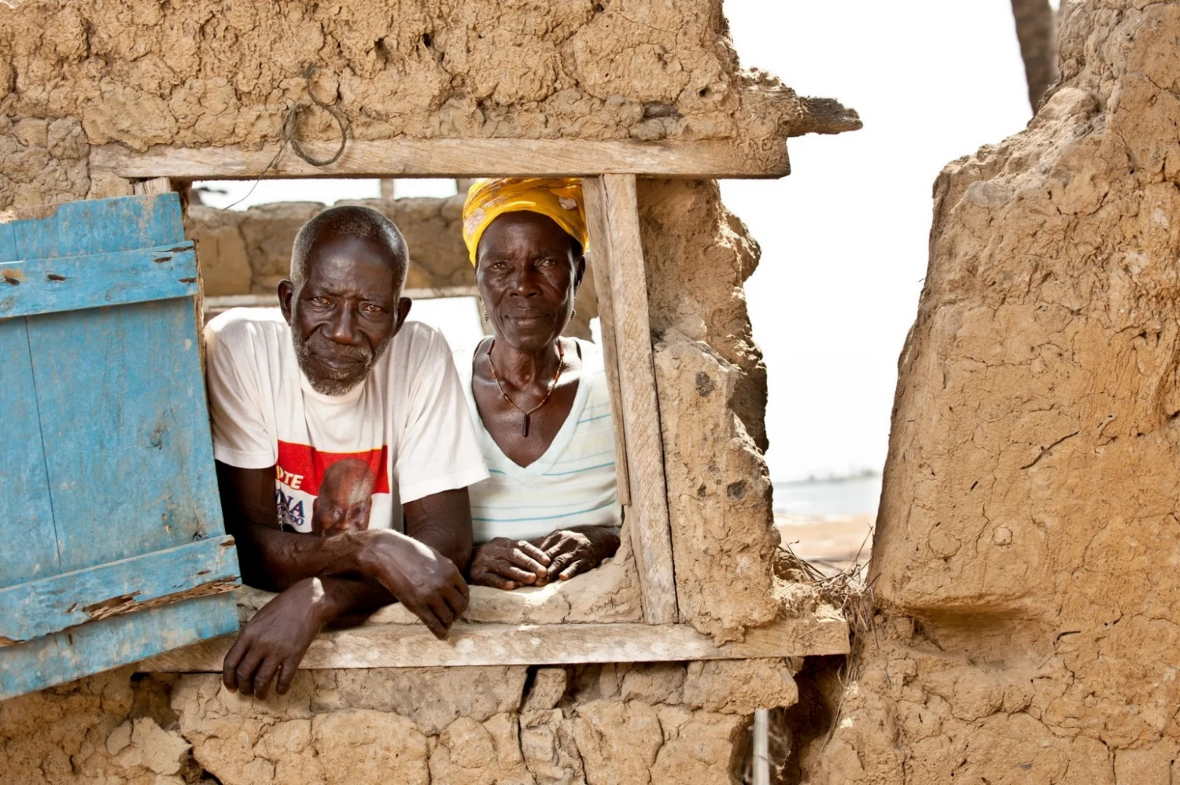
Anikor Adjawutor and Miyorhokpor Anikor look out from a window in their home on the nearby island of Azizakpe in the Volta Estuary which has been destroyed by rising waters. It is in a location that was once more than 100m from the water’s edge; it now floods monthly.
Photograph: Nyani Quarmyne/Panos Pictures
Source: https://www.theguardian.com/global-development-professionals-network/gallery/2016/oct/07/ghana-villages-destroyed-climate-change-in-pictures#img-8
Accessed: 30th September, 2022.
The University Library

Slide 14
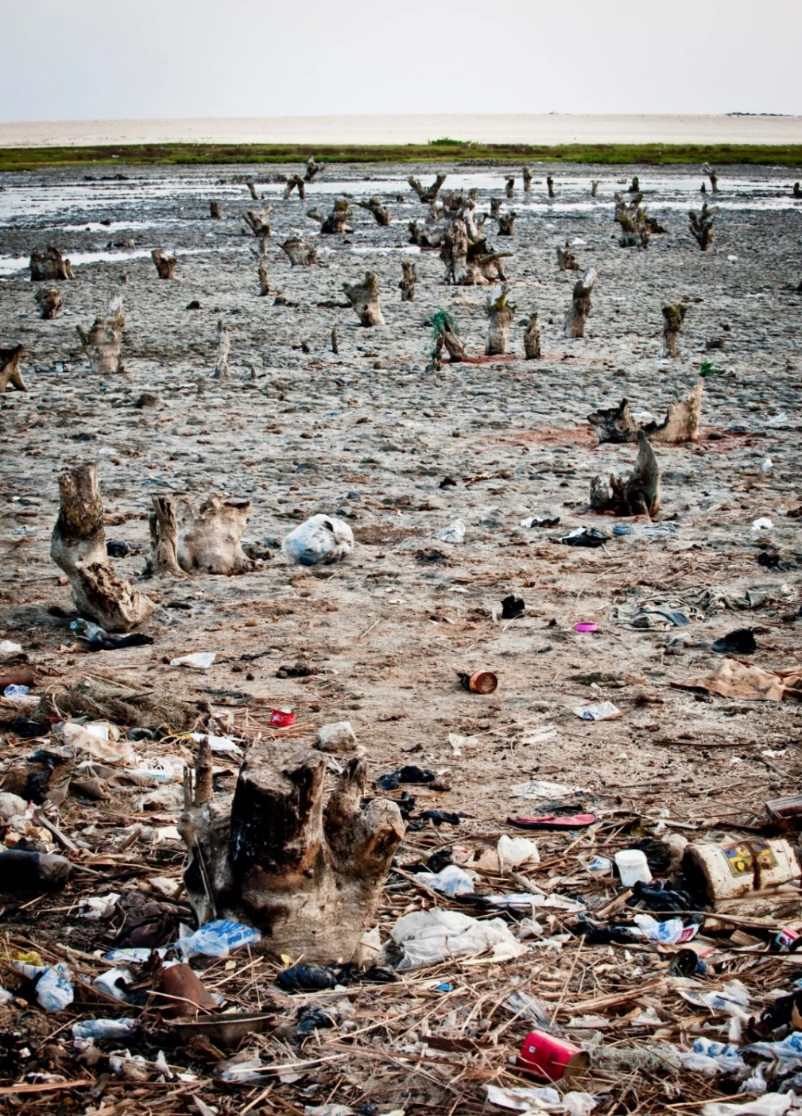
Rising salinity has killed trees around the village of Azizanya, Ada, in the Greater Accra Region leaving a barren mudflat.
Photograph: Nyani Quarmyne/Panos Pictures
Source: https://www.theguardian.com/global-development-professionals-network/gallery/2016/oct/07/ghana-villages-destroyed-climate-change-in-pictures#img-9
Accessed: 30th September, 2022.
The University Library

Slide 15
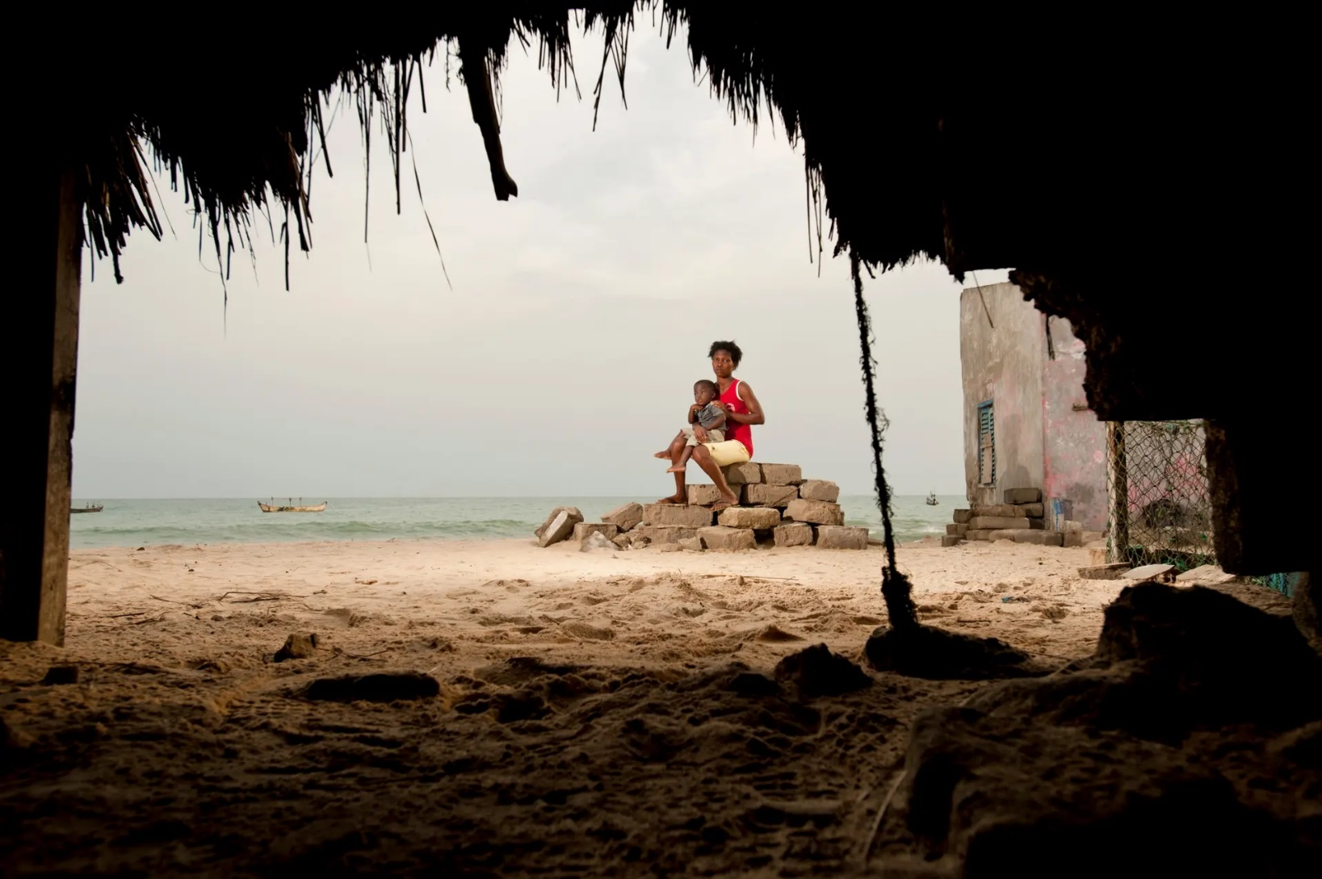
Hannah Abayateye and her son, Junior, sit on top of all that the sea has left of their traditional family home in the village of Akplabanya, Ada, in the Greater Accra Region.
Photograph: Nyani Quarmyne/Panos Pictures
Source: https://www.theguardian.com/global-development-professionals-network/gallery/2016/oct/07/ghana-villages-destroyed-climate-change-in-pictures#img-10
Accessed: 30th September, 2022.
The University Library

Slide 16
The Bonsa River
The current state of the Bonsa River, in the Tarkwa Nsuaem Municipality, as a result of indiscriminate mining. The encircled area shows some local residents swimming.
Photograph: Emmanuel Amoani Ofori
Location: Bonsa
Date: 10th August, 2022.
The University Library

Slide 17
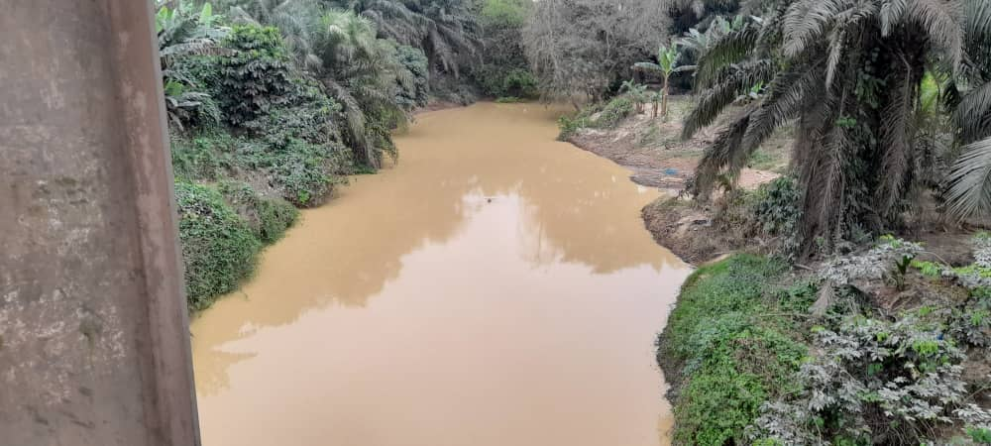
The Botire River
The Botire River, in the Tarkwa Nsuaem Municipality, which was formerly thought to be a clean and beneficial source of water for homes and farming activities, is fast deteriorating as a result of indiscriminate mining activities.
Photograph: Emmanuel Amoani Ofori
Location: Bonsa
Date: 10th August, 2022.
The University Library

Slide 18
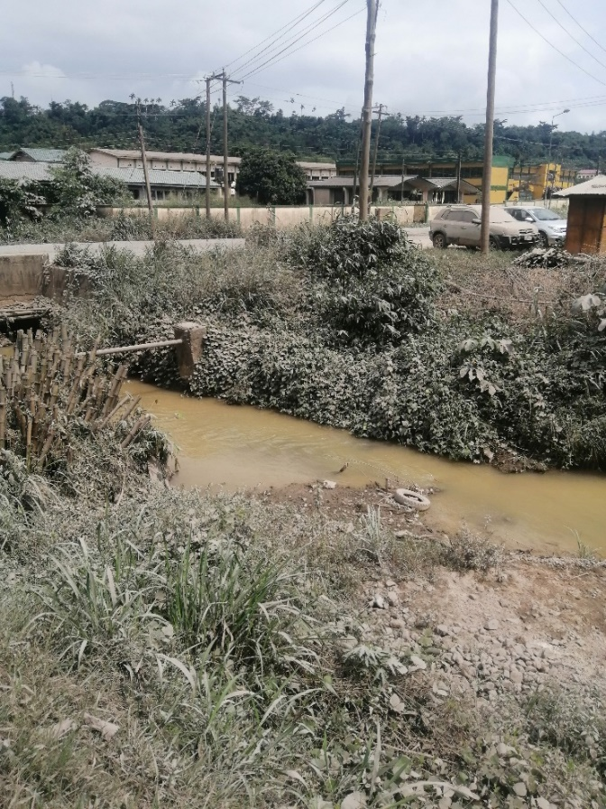
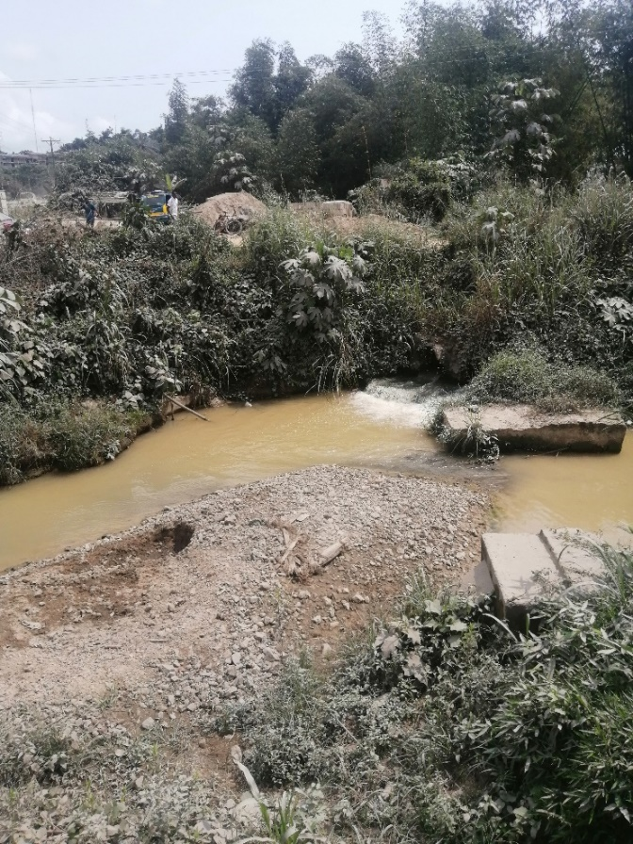
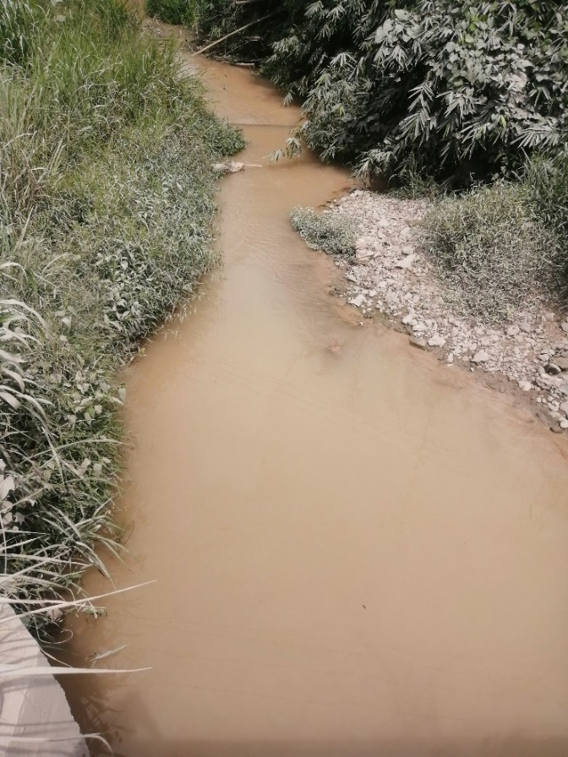
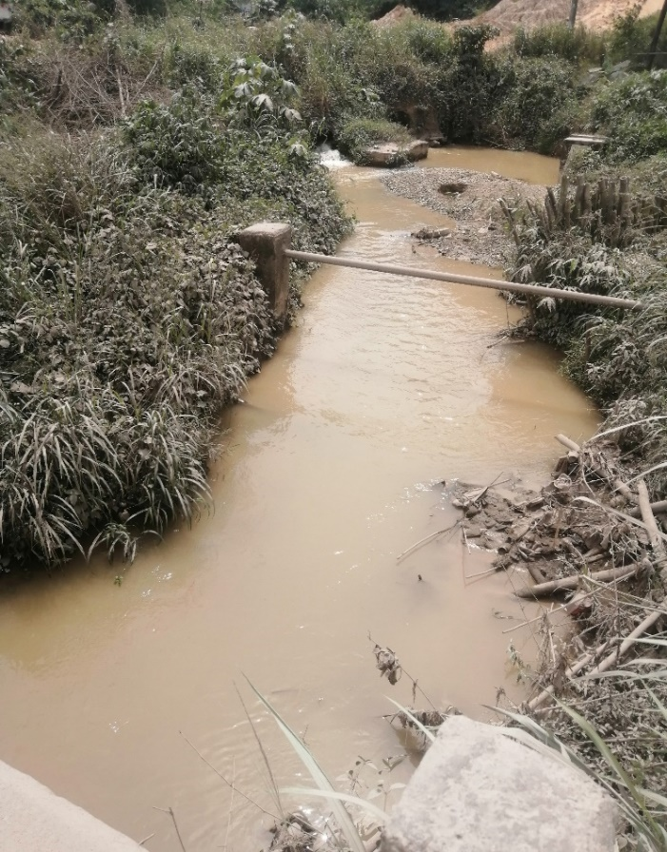
The Bediabewu River: It’s believed that, one dies after eating fish from the river hence the name “Bediabewu”. Also, history explains that, residents get infested with bilharzia when bathing or drinking from the river due to poor mining activities. Currently, the river is only suitable for washing. It is located in the Tarkwa Nsuaem Municipality.
Photograph: Cornelius Konnie Mensah Location: Tarkwa Date: 10th August, 2022.
The University Library

Slide 19
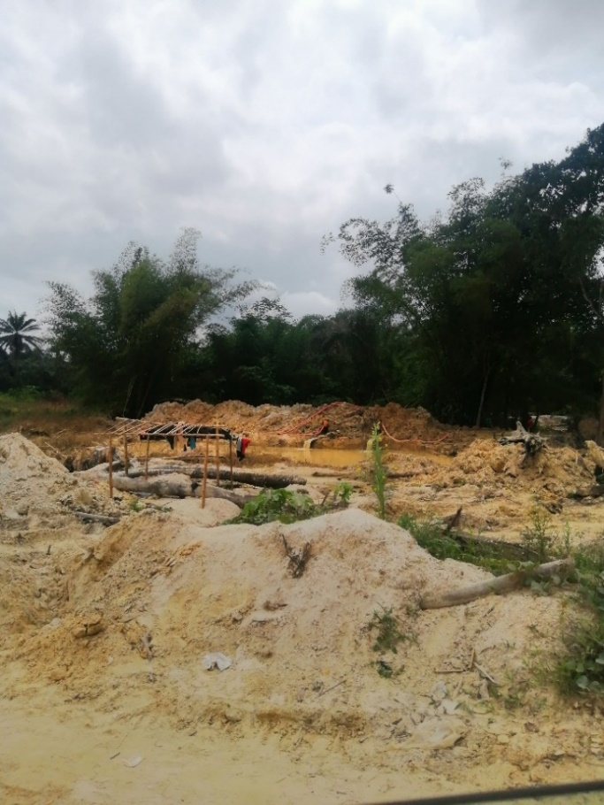
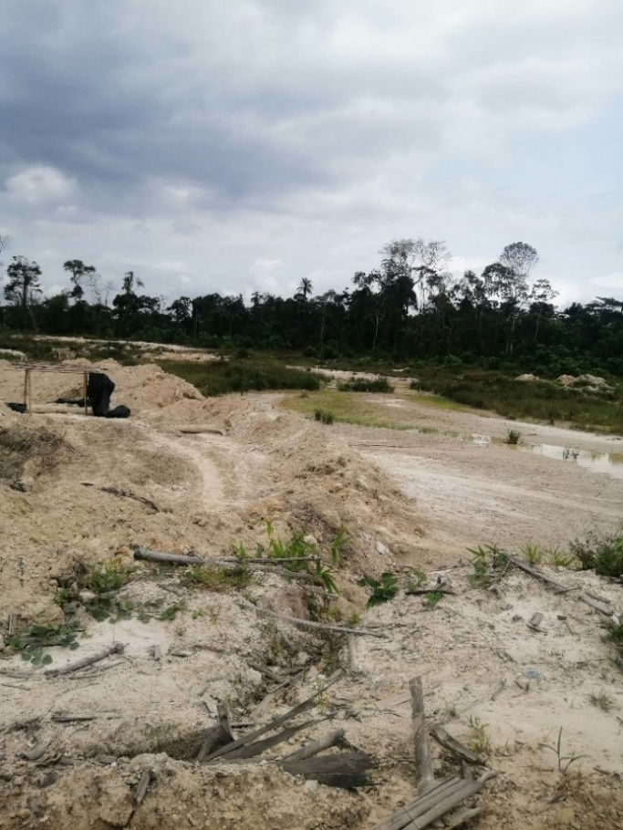
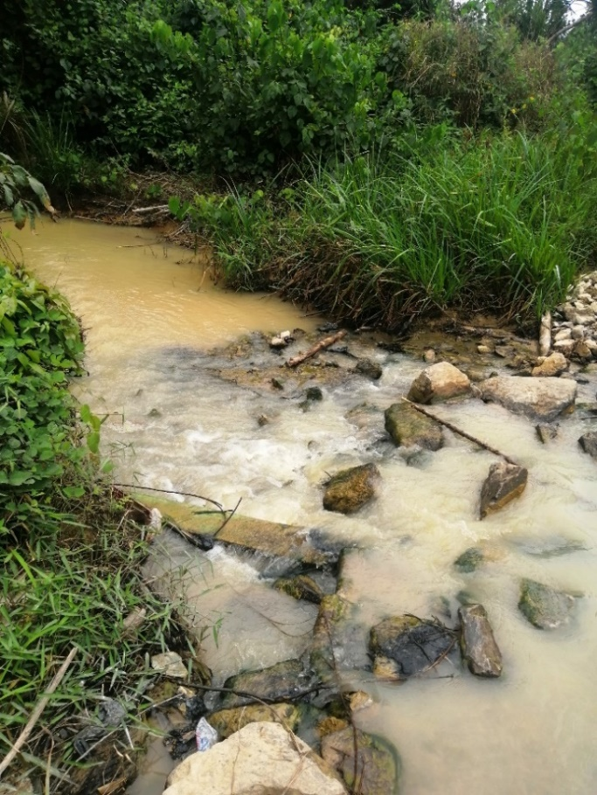
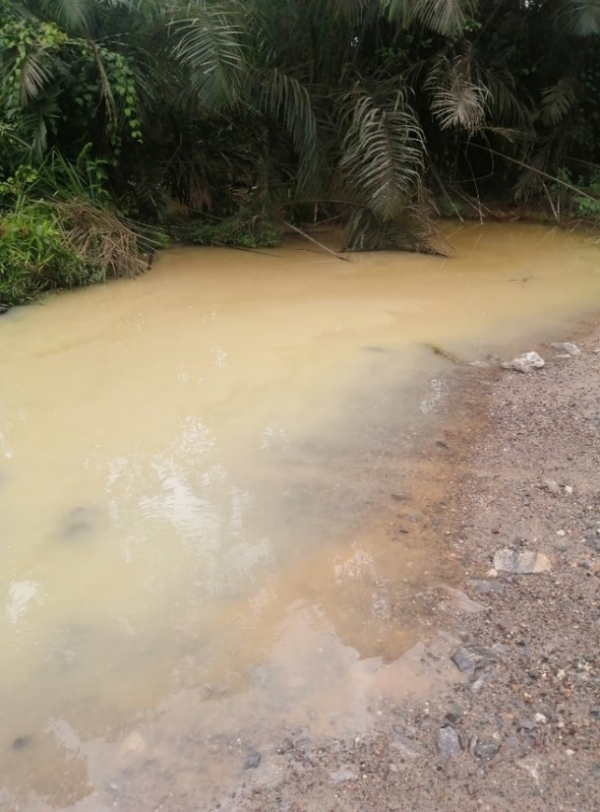
Kyirifi River at Awetieso
The current state of the Kyirifi River, in the Tarkwa Nsuaem Municipality due to illegal mining activities. In the past, this river served as a potable source of water for the people in the community.
Photograph: Cornelius Konnie Mensah Location: Tarkwa Date: 10th August, 2022.
The University Library

Slide 20
Compilation of National Newspaper Articles on the Environment and Illegal
Mining Activities
The University Library

Slide 21
Newspaper Articles on the Environment
Adams, C. N. (2021) ‘Ghana risks importing water if ...’, Ghanaian Times, 23 June, p. 16, 17.
Adzei, C. B. (2021) ‘Greening Ghana gathers momentum in W/R’, Ghanaian Times, 18 June, p. 10.
Affram-Mensah, B. (2021) ‘River Densu - a curse or a blessing?’, Ghanaian Times, 4 August, p. 09.
Agyeman, N. K. (2021) ‘Water mixed batteries now part of e-waste materials - MESTI’, Dailly Graphic,
12 May, p. 45.
Aklorbortu, D. K. (2021) ‘Ankobra River regaining quality’, Dailly Graphic, 25 May, p. 16, 37.
Aklorbortu, D. K. (2020) ‘Integrated waste management plant for Western Region’, Dailly Graphic, 21 August, p. 22, 27.
Aklorbortu, D. K. and Dzodzegbe, A. (2021) ‘Western North REGSEC stops quarry activities in forest reserve’, Dailly Graphic, 18 June, p. 23.
Anonymous (2021) ‘Youth Alliance commends govt for Green Ghana Initiative...appeals to it to secure
Atewa forest’, Ghanaian Times, 30 June, p. 23.
Anonymous (2021) ‘Govt steps up protection of water bodies’, Ghanaian Times, 21 April, p. 10.
Asare, T. (2021) ‘Tema Ramsar invasion, Dr Kwame Nkrumah’s tears’, Dailly Graphic, 16 August, p. 40, 41.
The University Library

Slide 22
Asiama, E. K. (2021) ‘Urgent need to salvage the environment’, Spectator, 10 July, p. 27.
Boye, C. A. (2020) ‘Daboase water treatment plant in danger! ...as galamsey activities pollute River Pra ... GWCL rations water to residents of Amenfi East area’, Ghanaian Times, 7 February, p. 15.
Cooper, N. (2021) ‘Govt urged to protect water bodies against illegal mining activities’, Ghanaian Times,
24 March, p. 25.
Daoyenikye, F. (2021) ‘Ya-Na pledges support for tree planting exercise’, Dailly Graphic, 1 June, p. 23.
Dapatem, D. A. (2021) ‘Project to mitigate flooding, solid waste management in Accra underway’,
Dailly Graphic, 28 June, p. 24, 41.
Dartey, D. Y. (2019) ‘Plastics in the belly of the earth’, Spectator, 23 November, p. 09.
Donkor, K. B. (2021) ‘Graphic dialogue on sanitation: Time to enhance education - Editor’, Dailly Graphic,
21 May, p. 33.
Duodu, C. (2019) ‘If I had enough resources to award a meaningful prize’, Ghanaian Times, 17 December, p. 08.
Folley, B. G. (2021) ‘2 c’nities in 2 municipalities lack potable water’, Ghanaian Times, 24 March, p. 32.
The University Library

Slide 23
Folley, B. G. (2019) ‘Environment minister calls for radical action to minimise plastic use’,
Ghanaian Times, 11 October, p. 07.
Fordjour, L. D. (2021) ‘Upper West marks World Environment Day’, Ghanaian Times, 7 June, p. 25.
Ghanaian Times Editorial (2021) ‘Chiefs can uproot the illegalities in our forests’, Ghanaian Times,
19 May, p. 04.
Gyasi, E. A. (2021) ‘Galamsey menace: The role of welding in the recovery process of Ghana’s polluted water bodies’, Ghanaian Times, 7 July, p. 09.
Kale-Dery, S. (2020) ‘Ghana charts road map to manage plastic waste’, Dailly Graphic, 5 February, p. 25.
Korankye, K. A. (2020) ‘Hurting the Tano river god with pollution’, Dailly Graphic, 28 January, p. 10.
Mensah, T. N. O. and Gyasi, E. A. (2021) ‘Goodbye to “Dumsor” ... harnessing renewables and
waste to generate sustainable electricity in Ghana’, Ghanaian Times, 12 June, p. 08.
Mustapha, S. (2019) ‘Restoring the vegetative cover of Akyem’, Graphic Business, 28 November, p. 36.
The University Library

Slide 24
Ngnenbe, T. (2020) ‘Operation Vanguard team to be deployed at Oda River Forest reserve’,
Dailly Graphic, 24 January, p. 32.
Nyavi, G. A. (2020) ‘Borla taxis given codes to prevent illegal dumping of waste’, Dailly Graphic,
13 August, p. 44.
Ocloo, D. R. (2020) ‘Management of liquid waste: Tema “leaks” from broken- down sewerage systems’, Ghanaian Times, 9 September, p. 43.
Ohene, E. (2021) ‘Green land of our birth’, Dailly Graphic, 16 June, p. 10.
Tachie-Menson, R. (2021) ‘Why Dormaahene tackles sanitation, environment matters with passion
and drive’, Ghanaian Times, 16 August, p. 08.
The Environment King (2019) ‘Operation cover the earth’, Dailly Graphic, 14 December, p. ss06.
Times Reporter (2021) ‘Reduce risks in water sector - A Rocha Ghana’, Ghanaian Times, 24 March, p. 13.
The University Library

Slide 25
Newspaper Articles on Illegal Mining Activities
Abdul-Razak, R. (2020) ‘3 grabbed for illegal mining’, Ghanaian Times, 31 January, p. 03.
Ablakwa, S. O. (2021) ‘Arrest galamsey kingpins’, Dailly Graphic, 8 June, p. 42.
Ackaah-Kwarteng, K. (2021) ‘Burning excavators or not in galamsey fight?’, Dailly Graphic,
19 May, p. 44.
Adams, C. N. (2021) ‘Ban illegal mining for 1 year... to streamline mining industry - Okyehene’, Ghanaian Times, 28 May, p. 18.
Adams, C. N. (2021) ‘Clamp down on illegal mining to protect water bodies, prevent depletion of forest - Asantehene to govt’, Ghanaian Times, 27 March, p. 15.
Adams, C. N. (2021) ‘Galamsey canker is national emergency ... let’s resolve to end it - Stakeholders’, Ghanaian Times, 16 April, pp. 16, 17.
Adams, C. N. (2021) ‘Govt bans manufacture of Changfangs countrywide’, Ghanaian Times,
21 August, p. 07.
Adu-Gyamerah, E. (2021) ‘Don’t leave galamsey fight to politicians - Methodist Bishop’,
Dailly Graphic, 11 May, p. 23.
The University Library

Slide 26
Adzei, C. B (2021) ‘Bonsa residents lament galamseyers polluting River Bonsa’, Ghanaian Times,
13 April, p. 23.
Adzei, C. B. (2021) ‘4 “galamseyers” arrested at Kwakukrom’, Ghanaian Times, 8 July, p. 03.
Adzei, C. B. (2021) ‘Illegal mining affecting water production in Daboase’, Ghanaian Times,
21 April, p. 25.
Adzei, C. B. and Sekyere, Y. T. (2021) ‘Sanitation minister tasks chiefs to join fight against galamsey’, Ghanaian Times, 21 April, p. 17.
Agyeman, N. K. (2019) ‘Withdrawal of operation vanguard will have dire consequences’, Dailly Graphic, 22 November, p. 20.
Agyeman, N. K. (2021) ‘China doesn’t condone illegal mining - Ambassador’, Dailly Graphic, 22 May,
p. 01, 03.
Agyeman, N. K. (2021) ‘Jinapor justifies burning of excavators’, Dailly Graphic, 1 July, pp. 16, 56.
Agyeman, T. A. (2019) Minister decries destruction of cocoa farms by “galamseyers”, Ghanaian Times, 3 December, p. 03.
Agyeman, T. A. (2021) ‘3 get 15 years for engaging in “galamsey”’, Ghanaian Times, 13 May, p. 03.
The University Library

Slide 27
Agyeman, T. A. (2021) ‘Support President to stop illegal mining - Ms Dapaah’, Ghanaian Times,
19 May, p. 10.
Aklorbortu, D. K. (2020) ‘4 perish in galamsey pit at Ellembelle’, Dailly Graphic, 22 January, p. 16.
Aklorbortu, D. K. (2020) ‘Water shortage hits Sekondi Takoradi, Galamsey resurgence blamed for situation’, Dailly Graphic, 29 January, p. 23.
Aklorbortu, D. K. (2021) ‘Illegal miners in Ellembelle destroy environment, Assembly moves in to halt activities’, Dailly Graphic, 24 March, p. 27.
Aklorbortu, D. K. and Dzodzegbe. A. (2021) ‘3 illegal miners jailed 45 yrs., fined GHC 720,000’,
Dailly Graphic, 10 June, p. 41.
Ali, B. M. (2020) ‘Two “illegal miners” die in abandoned pit’, Dailly Graphic, 1 February, p. 13.
Ali, B. M. (2020) ‘We’re determined to win fight against illegal mining - President’, Dailly Graphic,
14 September, p. 32, 49.
Amenuveve, V. (2021) ‘Minister reiterates govt’s commitment to responsible mining’, Dailly Graphic,
21 May, p. 27.
The University Library

Slide 28
Andoh, V. W. (2021) ‘China does not condone illegal mining, ball in our court’, Dailly Graphic,
29 May, p. 07, 10.
Andoh, V. W. (2021) ‘Hope of Ankobra, resolve to overcome galamsey’, Dailly Graphic,
12 June, pp. 07, 10.
Ankomah, A. A. (2021) ‘Beyond fight against galamsey - fixing regulation gap’, Dailly Graphic,
1 July, p. 28.
Anonymous (2021) ‘Illegal mining allegation: Court awards Prof. Frimpong Boateng GHC 1m damages’, Ghanaian Times, 21 August, p. 10.
Asare, G. E. (2021) ‘Identify, prosecute sponsors of illegal mining - Dr Lartey’, Dailly Graphic,
12 May, p. 19.
Asiedu-Addo, S. (2021) ‘2 Breman galamsey pit owners arrested’, Dailly Graphic, 28 May, p. 29.
Asiedu-Addo, S. (2021) ‘Breman Brofoyedur tragedy: Why 13-year-old boy died in galamsey pit’,
Dailly Graphic, 5 June, p. 22.
Asiedu-Addo, S. (2021) ‘Dozens trapped in galamsey pit at Breman Brofoyedur’, Dailly Graphic,
27 May, p. 16.
Asiedu-Addo, S. (2021) ‘Illegal mining hampers flow of River Offin’, Dailly Graphic, 18 May, p. 23.
The University Library

Slide 29
Asmah, F. G. (2021) ‘Galamsey fight: Government must investigate this!!!’, Spectator, 15 May, p. 13.
Asmah, F. G. (2021) ‘Galamsey plunder: Asomah-Cheremeh “cleared”?’, Spectator, 22 May, p. 13.
Asmah, K. (2021) ‘Lands minister must succeed in galamsey fight’, Dailly Graphic, 20 April, p. 17.
Baah, A. and Appiagyei, P. D. (2021) ‘Galamsey menace: President is right’, Dailly Graphic, 7 June, p. 37.
Baidoo, F. A. (2020) ‘Illegal Mining bounces back in Konongo Odumase’, Dailly Graphic, 18 August, p. 53.
Baneseh, M. A. (2019) ‘“Exton Cubic mining leases invalid”’, Dailly Graphic, 1 August, p. 54.
Bentil, N. L. (2020) ‘Unrestrained mining causes havoc at Kwabeng’, Dailly Graphic, 25 January, p. 12, 21.
Boadu, K. A. (2021) ‘Remain resolute in galamsey fight, Friends of rivers urges President Akufo-Addo’, Dailly Graphic, 19 May, p. 40.
Boafo, Y. (2021) ‘Don’t burn excavators’, Spectator, 15 May, p. 04.
Bonney, E. (2021) ‘Apply anti-galamsey laws rigidly - Consultative Dialogue’, Dailly Graphic,
16 April, p. 20.
Cameron, D. (2020) ‘Even if you win by promoting galamsey, can you govern people who have no water?’, Ghanaian Times, 25 August, p. 06.
The University Library

Slide 30
Citinewsroom.com (2021) ‘“Govt will challenge $15m illegal mining judgement debt”’, Ghanaian Times,
26 June, p. 12.
Daily Graphic Editorial (2021) ‘Let’s support Okyehene’s call on galamsey ban’, Dailly Graphic,
15 June, p. 07.
Dapatem, D. A. (2021) ‘President affirms operation Halt. Go to court over excavators’ destruction’,
Dailly Graphic, 27 May, pp. 01, 03.
Donkor, K. B. (2021) ‘Big issue: Illegal mining (2)’, Dailly Graphic, 31 May, p. 17.
Donkor, K. B. (2021) ‘Stop galamsey menace, Otumfuo charges minster’, Daily Graphic, 27 March, p. 25.
Donkor, K. B. (2021) ‘Galamsey menace: DCE’s, Chiefs must answer - Asantehene’, Dailly Graphic,
13 May, pp. 01, 03.
Donkor, K. B. (2021) ‘Illegal miners damage ECG installations in Ashanti’, Dailly Graphic, 15 May, p. 32.
Duodu, C. (2019) ‘Is the anti-galamsey glass half-full or half-empty?’, Ghanaian Times, 8 October, p. 08.
Duodu, C. (2019) ‘Let the trials begin!’, Ghanaian Times, 29 October, p. 08.
Duodu, C. (2019) ‘Our prosecution authorities have turned Ghana into a toothless old bulldog’,
Ghanaian Times, 3 December, p. 08.
The University Library

Slide 31
Duodu, C. (2021) ‘Ace Ankomah and the struggle against galamsey’, Ghanaian Times, 6 July, p. 08.
Duodu, C. (2021) ‘Our struggle against galamsey is gaining the attention of Ghanaians in the UK’, Ghanaian Times, 25 May, p. 08.
Duodu, C. (2021) ‘The Asafo, I repeat, can save Ghana from galamsey!’, Ghanaian Times, 8 June, p. 08.
Ekuful, C. (2021) ‘We’ll not back down on galamsey fight - Nitiwul’, Ghanaian Times, 20 May, p. 15.
Gbane, S. A. (2020) ‘Minister cautions galamseyers’, Ghanaian Times, 27 January, p. 25.
Ghanaian Times Editorial. (2020) ‘Where are the galamsey excavators?’, Ghanaian Times,
31 January, p. 04.
Ghanaian Times Editorial. (2021) ‘Embrace Otumfour’s advice to intensify war against galamsey’, Ghanaian Times, 29 March, p. 04.
Ghanaian Times Editorial. (2021) ‘The fight against galamsey deserves national support’,
Ghanaian Times, 27 May, p. 04.
Gibbah, G. B. (2021) ‘Join the fight against illegal mining - Clergy urged’, Ghanaian Times,
5 June, p. 24.
The University Library

Slide 32
GNA (2019) ‘2 farmers jailed for illegal mining’, Ghanaian Times, 5 December, p. 03.
GNA (2021) ‘Let’s work together to stop illegal mining, logging, others - Savannah Regional Minister’, Ghanaian Times, 10 April, p. 15.
Gobah, T. (2021) ‘Galamsey fight not “nine-day” wonder, Samuel Jinapor insists’, Dailly Graphic,
5 June, p. 13, 20.
Gyesi, Z. K. (2019) ‘5 million employed in illegal mining sector - Report’, Dailly Graphic, 7 October, p. 23.
Gyesi, Z. K. (2020) ‘NDC accuses govt of working against galamsey fight’, Dailly Graphic, 7 February, p. 20.
Hawkson, E. E. (2021) ‘“National security” operatives remanded over galamsey’, Dailly Graphic,
15 May, p. 25.
Hawkson, E. E. (2021) ‘Court declines hearing to Atewa “galamsey” case’, Dailly Graphic, 11 May, p. 29.
Hope, K. E. (2019) ‘50,000 Chinese are engaged in illegal mining in Ghana - Report’, Ghanaian Times,
23 October, p. 15.
Hope, K. E. (2020) ‘2 trapped to death in “galamsey” pit’, Ghanaian Times, 10 August, p. 03.
Hope, K. E. (2021) ‘Effect of Illegal mining: Heavy metals in kidneys of children’, Spectator, 10 July, p. 03.
The University Library

Slide 33
Hope, K. E. (2021) ‘GNASSM supports President’s move to depoliticise “galamsey” fight’,
Ghanaian Times, 13 January, p. 10.
Karikari, I. B. (2021) ‘Galamsey - sustainable perspective’, Dailly Graphic, 2 June, p. 07, 10.
Kenu, D. (2021) ‘4 Chinese to be deported over galamsey’, Dailly Graphic, 14 June, p. 26.
Kenu, D. (2021) ‘Give us seized excavators for production, vegetable farmers appeal’, Dailly Graphic,
2 June, p. 51.
Kenu, D. (2021) ‘Illegal miners to get 15-20 years imprisonment’, Dailly Graphic, 7 June, pp. 24, 41.
Kenu, D. (2021) ‘Stamp out galamsey, Chief Justice warns of stiffer punishment, AngloGold Ashanti insists on political will’, Dailly Graphic, 11 June, pp. 01, 03.
Kenu, D. (2021) ‘Streamline anti-galamsey operations, cocoa merchant urges govt’, Dailly Graphic,
21 May, p. 23.
Koomson, J. B. (2021) ‘Galamsey wreaks havoc, vast swathes of forests, rivers devastated in Eastern, Western regions’, Dailly Graphic, 20 May, pp. 01, 03.
The University Library

Slide 34
Korankye, K. A. and Hawkson, E. E. (2021) ‘President cannot endorse excavator burning - Martin Kpebu’, Dailly Graphic, 31 May, p. 49.
Kyei-Boateng, S. (2020) ‘Upsurge in illegal mining at Akyem Nkwantanan worrying - Chief’,
Dailly Graphic, 27 January, p. 26.
Mensah, M. (2020) ‘Missing galamsey excavators: 6 busted’, Dailly Graphic, 5 February, pp. 01, 03.
Mirror Editorial. (2021) ‘Save the orange farms in Obuasi’, Mirror, 3 July, p. 02.
Modey, E. (2020) ‘3 illegal gold miners in Wa’, Dailly Graphic, 31 January, p. 21.
Myjoyonline.com (2021) ‘Galamsey fight: Excavators’ destruction regrettable - Nana Yaa Jantuah’, Ghanaian Times, 18 June, p. 12.
News Desk Report (2019) ‘Don’t give out cocoa farms for illegal mining - COCOBOD CEO’,
Dailly Graphic, 4 December, p. 61.
Ngnenbe, T. (2019) ‘Aowin Omanhene decries resurgence of illegal mining’, Dailly Graphic,
23 October, p. 64.
The University Library

Slide 35
Ngnenbe, T. (2019) ‘Don’t engage in galamsey, Minister urges women’, Dailly Graphic, 29 October, p. 29
Ngnenbe, T. (2019) ‘Galamsey: When a national asset becomes a curse’, Dailly Graphic, 16 December,
pp. 40, 41.
Ngnenbe, T. (2020) ‘Galamsey operators invade Oda River Forest reserve’, Dailly Graphic, 18 January,
p. 32.
Ngnenbe, T. (2020) ‘Small scale Miners Association renew commitment to galamsey fight’, Dailly Graphic, 28 September, p. 20.
Ngnenbe, T. (2021) ‘Fighting galamsey: Our water, our life’, Dailly Graphic, 31 May, p. 40, 41.
Ngnenbe, T. (2021) ‘Minister affirms commitment to fight galamsey’, Dailly Graphic, 18 August, p. 25.
Osei, F. K. (2019) ‘Disband inter-ministerial committee on illegal mining - Ken Ashigbey’,
Ghanaian Times, 28 September, p. 19.
Owusu, S. A. (2021) ‘Stopping galamsey, restoring ecosystems’, Dailly Graphic, 16 June, p. 07.
Petesi, J. Y. (2021) ‘Fight against galamsey: Lands minister justifies burning of excavators’, Ghanaian Times, 1 July, p. 24.
The University Library

Slide 36
Report (2021) ‘“The galamsey entrepreneurs” launched to commemorate Maj. Mahama’s 4th anniversary’, Spectator, 14 August, p. 08.
Report (2021) ‘Havoc caused by illegal miners’, Dailly Graphic, 22 May, p. 29.
Salia, A. K. (2021) ‘Big issue: Illegal mining’, Dailly Graphic, 17 May, p. 17.
Times Reporter (2021) ‘6 galamseyers arrested, guns, ammunitions seized’, Ghanaian Times, 27 March, p. 13.
Times Reporter (2021) ‘Arrest, prosecute financiers, overlords of galamsey activities - Okudzeto Ablakwa’, Ghanaian Times, 24 May, p. 15.
Times Reporter (2021) ‘Minister urges taskforce to clamp down on use of changfangs’, Ghanaian Times,
23 August, p. 15.
Times Reporter (2021) ‘Occupy Ghana disagrees with “burn on sight” approach to fighting galamsey’, Ghanaian Times, 29 May, p. 19.
Times Reporter (2021) ‘Okyehene fumes at galamseyers for polluting water bodies’, Ghanaian Times,
18 May, p. 15.
Times Reporter (2021) ‘Taskforce destroys machines, canoes belonging to “galamseyers” on Ankobra river’, Ghanaian Times, 19 August, p. 03.
The University Library

Slide 37
FREE ONLINE EDUCATIONAL PORTALS
The University Library

Slide 38
Free Online Educational Portals
Useful Search Engine for Books | Website
PDFDRIVE | https://www.pdfdrive.com
PROJECT GUTENBERG | http://www.gutenberg.org
INTERNET ARCHIVES | https://archive.org/details/texts
NB: These websites grants access to millions of books (PDF) for free relating to any subject/field of topic.
Useful Online Educational Support | Website
KHAN ACADEMY | https://www.khanacademy.org
ACADEMIC EARTHS | https://academicearth.org
COURSERA | https://www.coursera.org
EDX | https://www.edx.org
OPEN2STUDY | https://www.open2study.com
CODE ACADEMY | https://www.codecademy.com
YOUTUBE EDUCATION | https://www.youtube.com/education
NB: These resources host thousands of free online courses, in several disciplines, along with free learning materials (audios, videos, books etc.) for lifelong learning.
The University Library

Slide 39
Free Online Educational Portals - cont’d
Other Free Book Sites | Website
BOOK BOON | https://bookboon.com
EBOOKEE | https://ebookee.org
FREE BOOKS | http://www.freebooks.com/textbooks
MANY BOOKS | http://manybooks.net
BOOK YARDS | https://www.bookyards.com/en/welcome
GET FREE BOOKS | https://www.getfreeebooks.com
ESSAYS | http://www.essays.se
SPARK NOTES | http://www.sparknotes.com
PINK MONKEY | http://www.pinkmonkey.com/index2.asp
COMPUTER BOOKS | http://freecomputerbooks.com
NB: These additional websites grants access to millions of books (PDF) for free relating to any subject/field of topic.
The University Library

Slide 40
Free Online Educational Portals - cont’d
Useful Online Educational Support | Website
OPEN EDUCATION CONSORTIUM | https://www.oeconsortium.org/courses
UP-MADRID OPEN COURSEWARE INITIATIVE | http://ocw.upm.es
OPEN LEARN | http://www.open.edu/openlearn
USSU-UTAH OPEN COURSEWARE INITIATIVE | https://digitalcommons.usu.edu/ocw
UM-MICHIGAN OPEN COURSEWARE INITIATIVE | https://open.umich.edu
NB: These resources host thousands of free online courses, in several disciplines, along with free learning materials (audios, videos, books etc.) for lifelong learning.
Useful Medical Information Sites | Website
Health A to Z | http://www.healthatoz.info
MEDICAL LIFE SCIENCES | https://www.news-medical.net
HAVARD HEALTH PUBLISHING | https://www.health.harvard.edu/health-a-to-z
MED EXPLORER | http://www.medexplorer.com
US NATIONAL LIBRARY OF MEDICINE | https://www.nlm.nih.gov
MEDICINE NET | https://www.medicinenet.com/script/main/hp.asp
WEB MD | https://www.webmd.com
PLANET WELLNESS | http://www.planetwellness.com
NB: These resources host thousands of free medical information (audios, videos, books, articles, etc.)
The University Library

Slide 41
Free Online Educational Portals Cont’d
Answers to Questions | Website
EHOW | https://www.ehow.com
WHAT IS | https://whatis.techtarget.com
HOW STUFF WORK | https://whatis.techtarget.com
WEBOPEDIA | https://www.webopedia.com
PLAGTRACKER | http://www.plagtracker.com
ANSWERS | http://www.answers.com
QUORA | https://www.quora.com
Search Sites/Portals/Engines | Website
ABOUT or DOTDASH | https://www.about.com
GOOGLE | https://www.google.com
ASK JEEVES | https://askjeeves.net
EXCITE | http://www.excite.com
HOTBOT | https://www.hotbot.com
LOOK SMART | https://www.looksmart.com
LYCOS | http://www.lycos.com
OPEN DIRECTORY | http://dmoz-odp.org
WEB CRAWLER | https://www.webcrawler.com
AOL | https://www.aol.com
BING | https://www.bing.com
DOGPILE | http://www.dogpile.com
Search for People Portals | Website
ANY WHO | http://www.anywho.com
INFO SPACE | http://www.infospace.com
WHITE PAGES | https://www.whitepages.com
WHO WERE | http://www.whowhere.com
The University Library

Slide 42
Free Online Educational Portals - cont’d
Useful International News Sites | Website
ABC NEWS | https://abcnews.go.com
CBS NEWS | https://www.cbsnews.com
CNN NEWS | https://edition.cnn.com
FOX NEWS | http://www.foxnews.com
BBC NEWS | https://www.bbc.co.uk/news
ALJAZEERA NEWS | https://www.aljazeera.com
NEW YORK TIMES | https://www.nytimes.com
FRANCE 24 NEWS | http://www.france24.com/en
MSNBC NEWS | http://www.msnbc.com
PUBLICO NOTÍCIA | https://www.publico.pt
Useful Sports News Sites | Website
GOAL | http://www.goal.com/en
ESPN | http://www.espn.com
SKY SPORTS | http://www.skysports.com
CNN SPORTS | https://edition.cnn.com/sport
FOX SPORTS | https://www.foxsports.com
NBC SPORTS | https://www.nbcsports.com
SPORTING NEWS | http://www.sportingnews.com
SPORTS ILLUSTRATED | https://www.si.com
The University Library

Slide 43
References
AFLIA, https://web.aflia.net, accessed: May 10, 2018.
Business & Human Rights Resource Centre, https://www.business-humanrights.org/en/latest-news/ghana-60-of-water-bodies-polluted-due-to-illegal-mining-and-other-activities-say-authorities, accessed: 20th August, 2022.
Mavodza, J. (2013), A review of the Open Access concept in UAE, New Library World, vol.114, No. 56, pp. 259-266
The Guardian, https://www.theguardian.com/global-development-professionals-network/gallery/2016/oct/07/ghana-villages-destroyed-climate-change-in-pictures, accessed: 30th September, 2022.
www.sparcopen.org/news/2022/theme-for-open-access-week-2022-openfor -climate -justice/ accessed: 20th August 2022.
The University Library

Slide 44
Thank you.
The University Library

