Slide 1

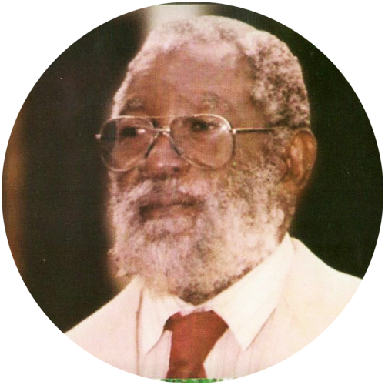

University of Mines & Technology, Tarkwa
The University Library
INTERNATIONAL ARCHIVES WEEK
#ArchivesUnited: The Life of a Pioneer from our Institutional Archives
5th - 9th June, 2023
TEAM MEMBERS
Abigail E Tadimie Emmanuel A Ofori
Ernest E Davies
Jonathan A Dotse Kojo O Obeng
Korklu A Laryea (Coordinator, Archives Committee)
Background music (Adikaŋfo, Mo!) composed by Dr. Ephraim Amu
Dr. Michael Tetteh Kofi

Slide 2
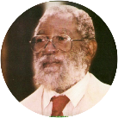

Overview
This year’s ICA celebration is on the theme #75YearsICA, to mark its diamond anniversary.
The University of Mines and Technology, which is seventy years old, joined the ICA in 2021 and has since celebrated the International Archives Week.
This year, we share from the Institution’s archives about Dr. Michael Tetteh Kofi, the Institution’s first Ghanaian Principal.
Information for this sneak preview in honour of a pioneer in mining education was gathered from the University Archives and his funeral brochure, Call to glory: burial and memorial service for the late Dr. Michael Tetteh Kofi, 19th November, 2022.
The University Library

Slide 3
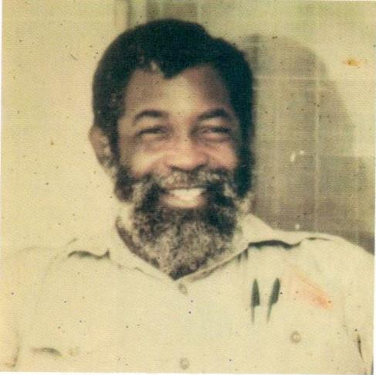
Dr. Michael Tetteh Kofi, born on 3rd May, 1929 at Odumase-Krobo.
He attended Presbyterian Boys’ Secondary School, Odumase-Krobo, between 1945 and 1960 and University of Newcastle-Upon-Tyne, England, between 1970 and 1972.
He worked as a Mathematics teacher at Adabraka Government Primary School and James Town Primary School, between 1953 and 1956.
3
The University Library

Slide 4
From December 1956 he was at Tarkwa Technical Institute, December where he taught Mathematics, Science, Rock Mechanics, Soil Mechanics, Mechanical and Electrical Engineering, was recommended to teach Geology and Theoretical Surveying.
He was also the Industrial Liaison Officer, and the supervisor of the carpentry and masonry workshops.
Ultimately, he became the first Ghanaian Principal and served in that capacity from 1976 till 1995.
Also known as ‘Tarkwa Governor’, Dr. Kofi retired from the University after thirty-nine years of service.
4
The University Library

Slide 5
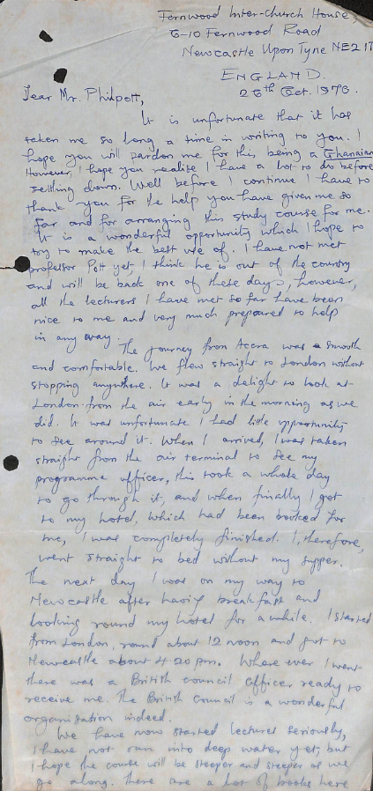
Mr. Kofi was awarded a British Council scholarship in 1970 to study for a Master’s degree in Rock Mechanics and Excavation Engineering, at the University of Newcastle-Upon-Tyne, England.
This is the first of many letters he wrote to Mr. J E Philpott (Principal, Tarkwa School of Mines, 1952 – 1975) during his study leave in England.
The University Library

Slide 6
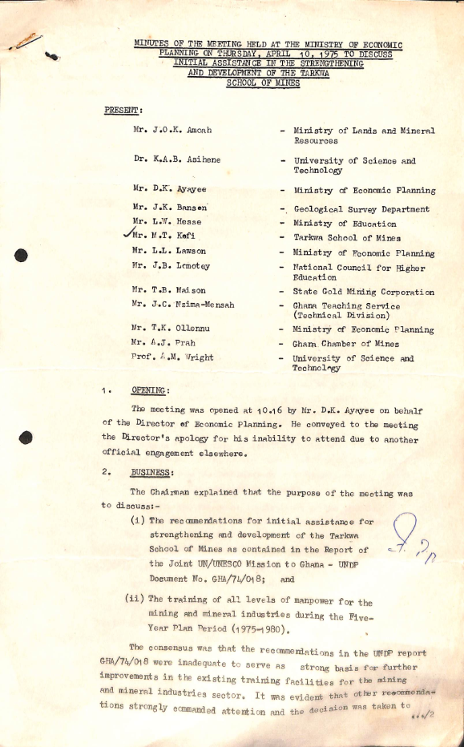
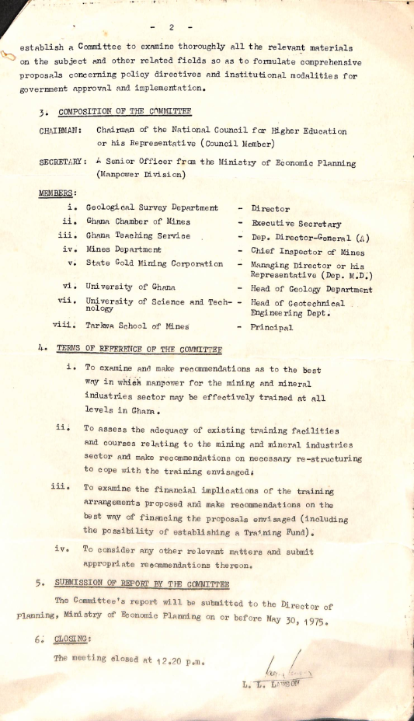
Minutes of a meeting held to strengthen the pillars for building UMaT, at the Ministry of Economic Planning, on 10th April, 1975.
This was during the National Redemption Council regime (1972 – 1975).
The University Library

Slide 7
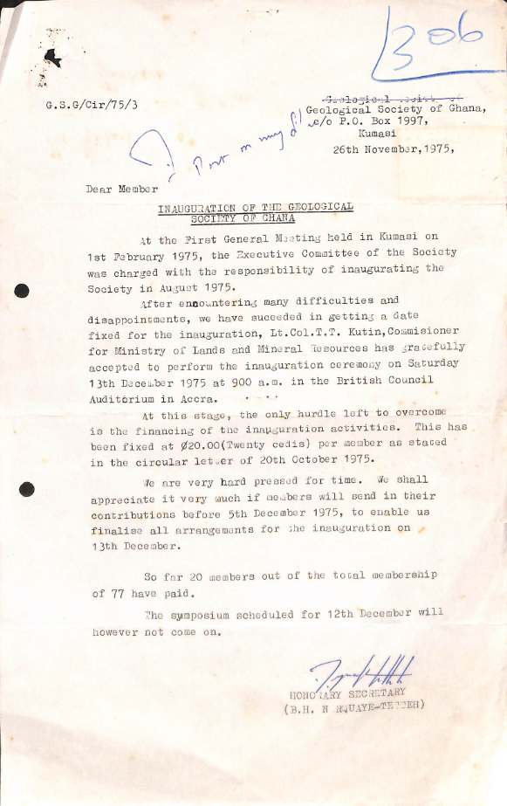
He was active in professional bodies like the Ghana Institution of Engineers, the Institution of Engineers, United Kingdom, and the Geological Society of London.
He was present at the founding of the Geological Society of Ghana which was inaugurated on 13th December, 1975.
The University Library

Slide 8
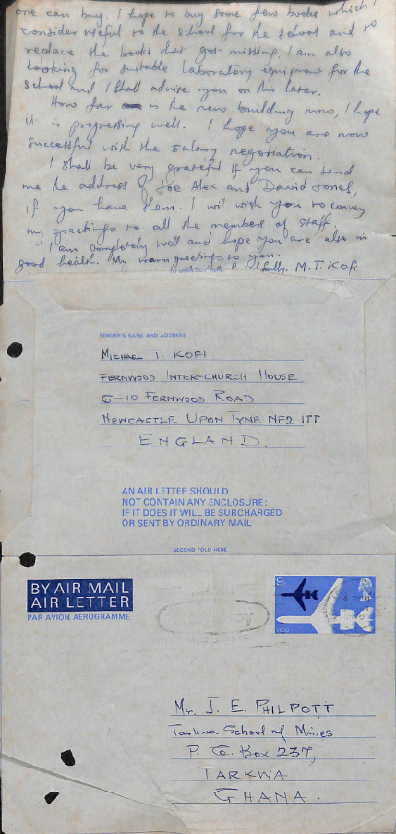
While away, he thought of getting books for himself and the Library, and some laboratory equipment for the School.
Which of the buildings on campus was being constructed in 1970?
The letter was written on 26th October, 1970 and posted on 4.30pm a few days later.
The cost and postage of the letter card (also known as an aerogramme which bore the profile of Queen Elizabeth), was 9p.
The University Library

Slide 9
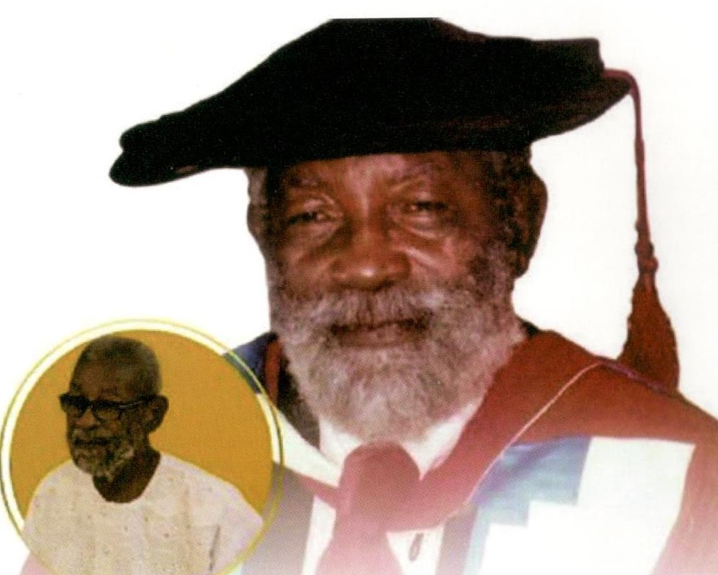
He sacrificed his pursuit of a PhD and returned to Ghana, to understudy Mr. Philpott.
A consummate academic, it was under his watch that diploma certificates, bachelor, and post-graduate professional degrees in mining engineering and allied fields were introduced at UMaT.
Courses for middle and top level management personnel in the mining and allied fields were also designed and offered during his tenure as Principal.
He was the first chairman of the Council of Takoradi Polytechnic.
The University Library

Slide 10
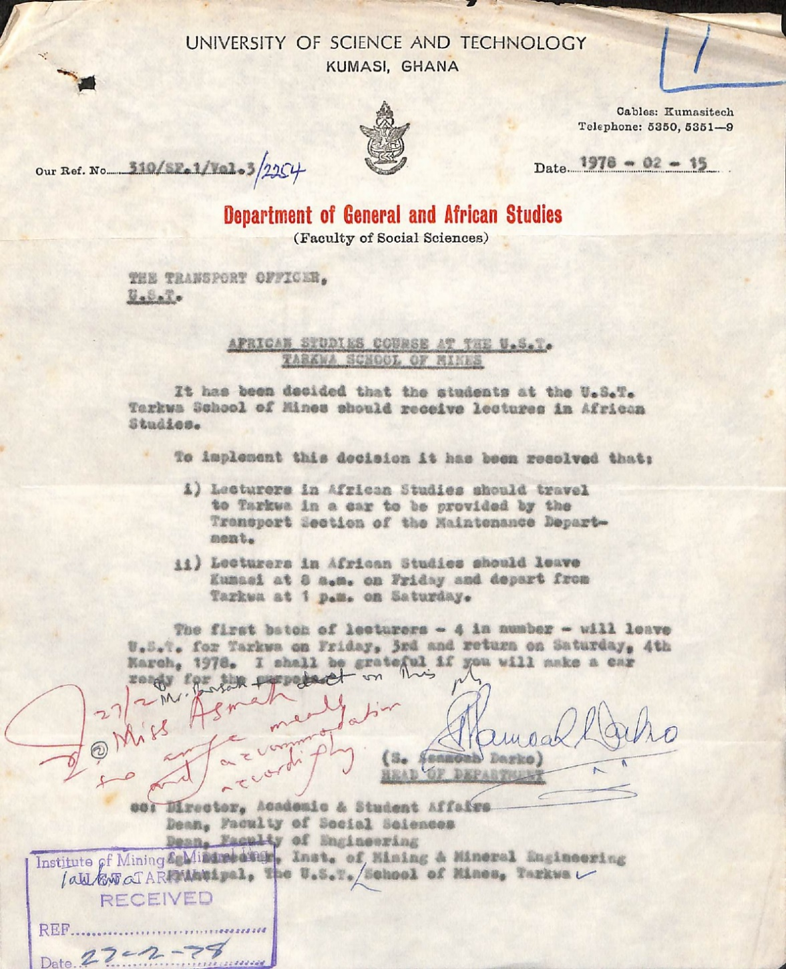
African Studies was also taught to ground the students in their context. The first group of lecturers, who started lecturing on 3rd March, 1978, were Dr. J Dombrowski, Prof. M A Kwamena-Poh (leader), Mr. S F Galevo, and Miss Catherine Acquah.
The course was scrapped when the University gained autonomy from the University of Science and Technology.
The University Library

Slide 11
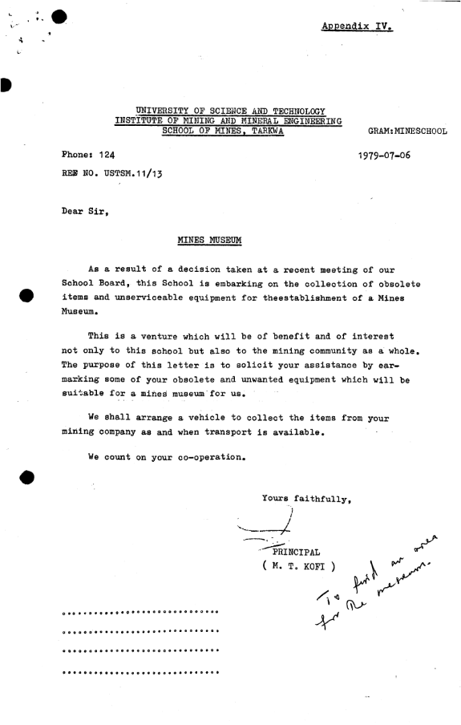
The establishment of a mining museum has been actively pursued in recent years. This letter in 1979 testifies to the interest in a museum by the University though the notion goes several years back (as shown in the next slide).
The question of where to locate the museum is ongoing; whilst the collection of materials and archives is being pursued to prevent total loss of our mining heritage.
The University Library

Slide 12
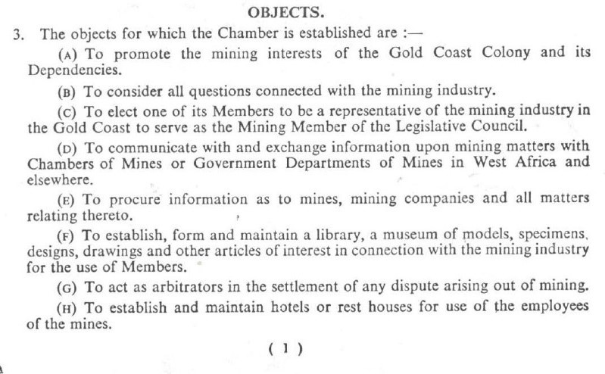
The Memorandum of Association of the Gold Coast Chamber of Mines, in the Companies Ordinance (CAP 156), Gold Coast Colony and Ashanti, had as objects (E) and (F), procurement of information on mines and mining, and the establishment of a museum and a library.
The Ghana Chamber of Mines was incorporated as a company with the name Gold Coast Chamber of Mines, on 6th June 1928, and operated in Tarkwa, Western Region. The present name came by default on the attainment of Ghana’s independence on 6th March, 1957.
The University Library

Slide 13
Dr. Kofi on one of his foreign trips visited Germany.
Here, he (middle) is seen with Prof. Dr. W Drayer and his wife, at the entrance of the Miners’ Museum in Zellerfeldon, in 1983.
The University Library

Slide 14
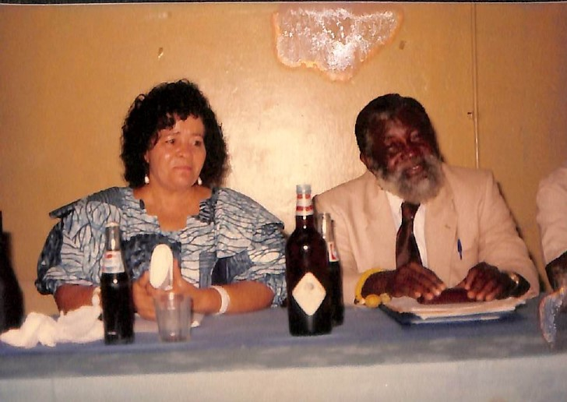
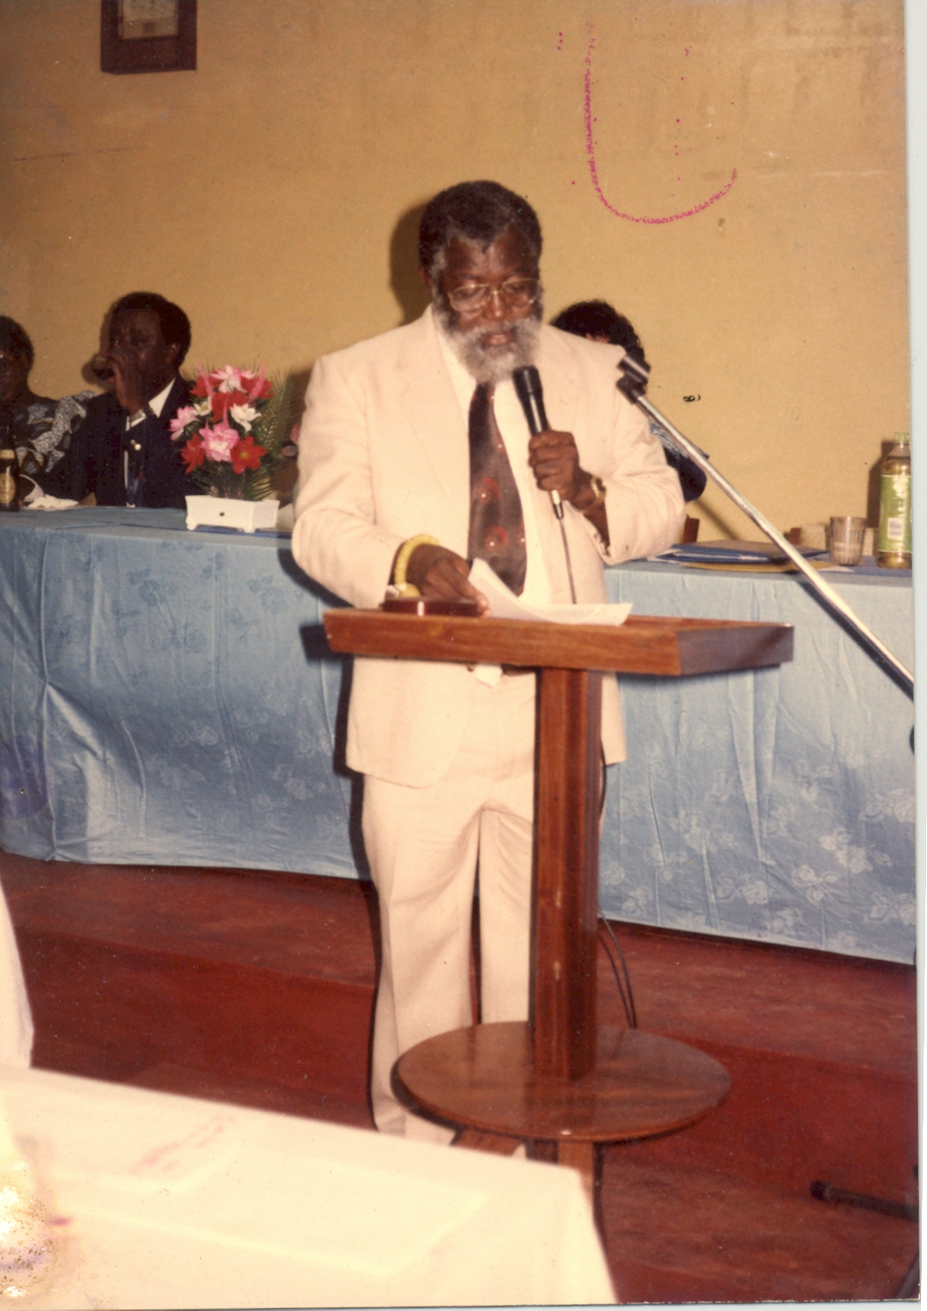
Dr. Kofi was also steeped in his culture as a Krobo. Notice the bead on his right wrist. Beads play a significant role in Krobo society and economy. Specific beads or strings of beads may be worn to signify wealth, rank or office, position of authority, religious/social cult, childbirth position, as well as the phase of life from birth to death and the afterlife.

Slide 15
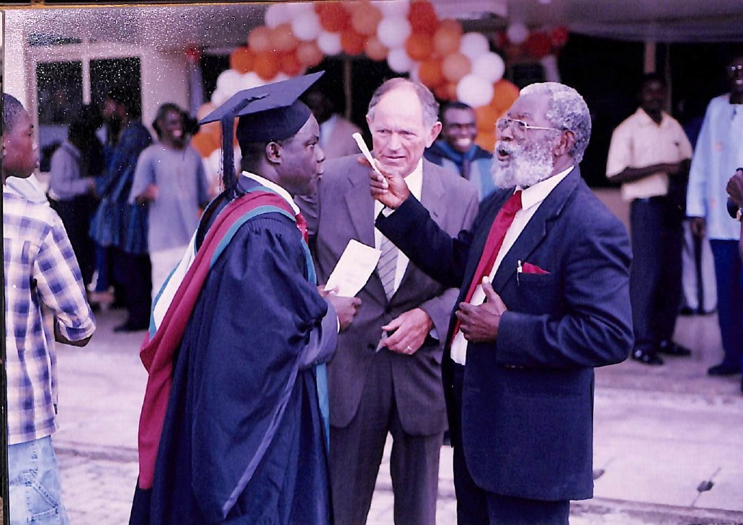
Dr. Kofi with a guest (middle) and Mr. E K Bedai (left) at the entrance of the University Library after its commissioning by Pres. J A Kufuor, on 18th August, 2005
Mr. Bedai served the Institution in various capacities and was the Registrar of the University from 2007 till 2018.
Dr. Kofi was said to be a man of few words but he seems to be in full flight in this picture. Perhaps, the topic of the hearty conversation was on music considering that both men were choristers in their various churches.
The University Library

Slide 16
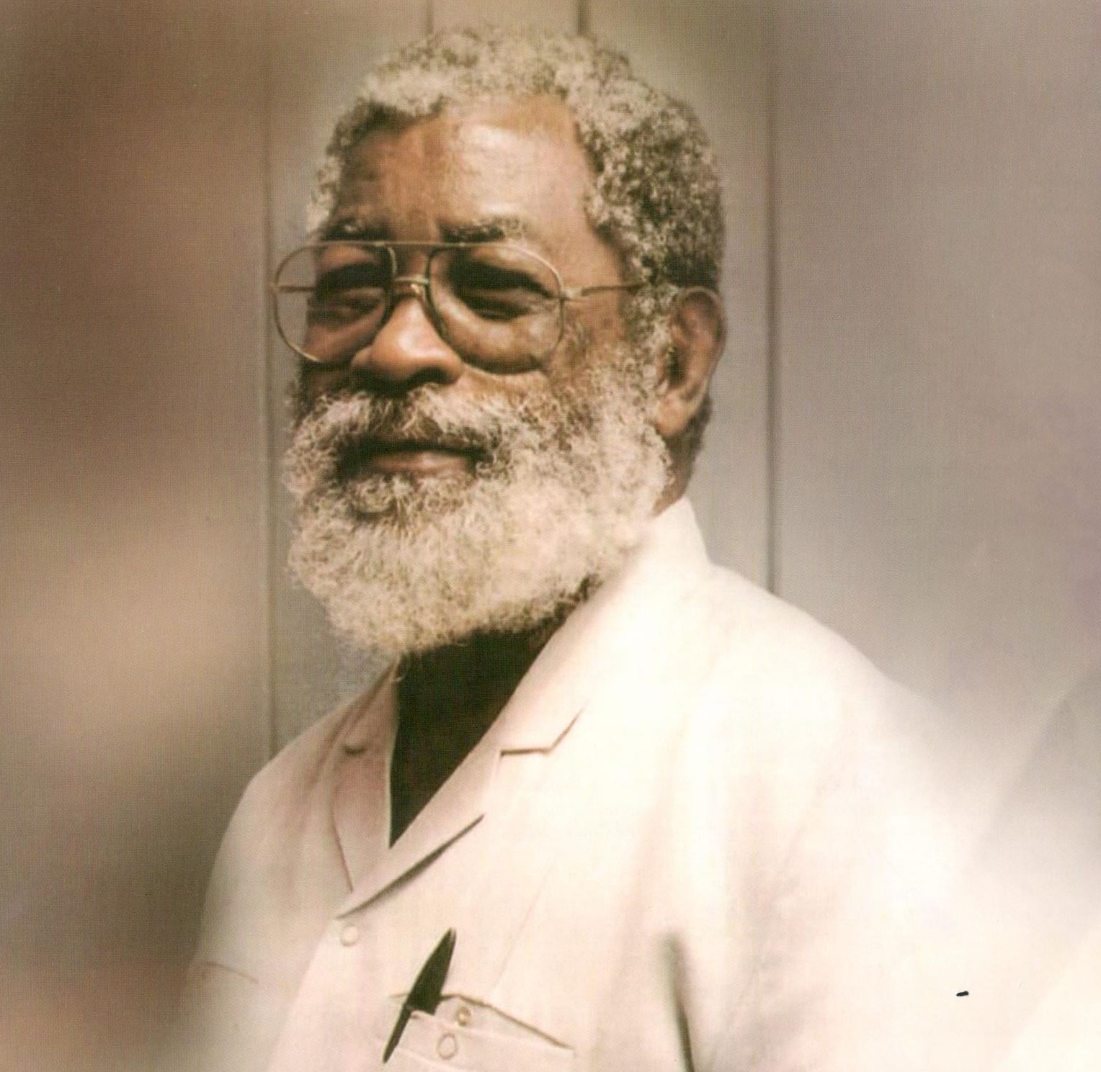
His input at national level was phenomenal:
As a member of the Technical Committee of the Ghana Chamber of Mines, he was instrumental in the development of relevant courses to train professionals in the mining and allied industries;
Helped the National Council of Tertiary Education (NTCE) to restructure the country’s technical and vocational institutions into polytechnics.
He was deservedly honoured with a Doctor of Science (Honoris Causa) by the University in 2012. A students’ hall of residence was built and dedicated to his memory in 2016.
His bust, is one of four gracing the front of E K Bedai Block of the University.
He died on 19th August, 2022 and was buried on 19th November, 2022 at his hometown, Odumase-Krobo, Eastern Region.
The University Library

Slide 17
Sources Used
Call to glory: burial and memorial service for the late Dr. Michael Tetteh Kofi. November, 2022.
The Ghanaian bead tradition. 2nd ed., Ghana Bead Society, Special Paper 1, 1995.
The Gold Coast (now Ghana) Chamber of Mines. Twenty-ninth Annual Report, 1st April 1955 – 31st March, 1956.
Schecschel, M. ‘A collection of photographs taken of M T Kofi during his tour in Germany’, 1983.
Sutherland-Addy, E, Aidoo, A A, & Dagadu, Kati T. Ghana, where the bead speaks, Foundation for Contemporary Art-Ghana, 2008.
The University Library

Slide 18

Odikaŋfo, da yiye.
The University Library

